Slide 1

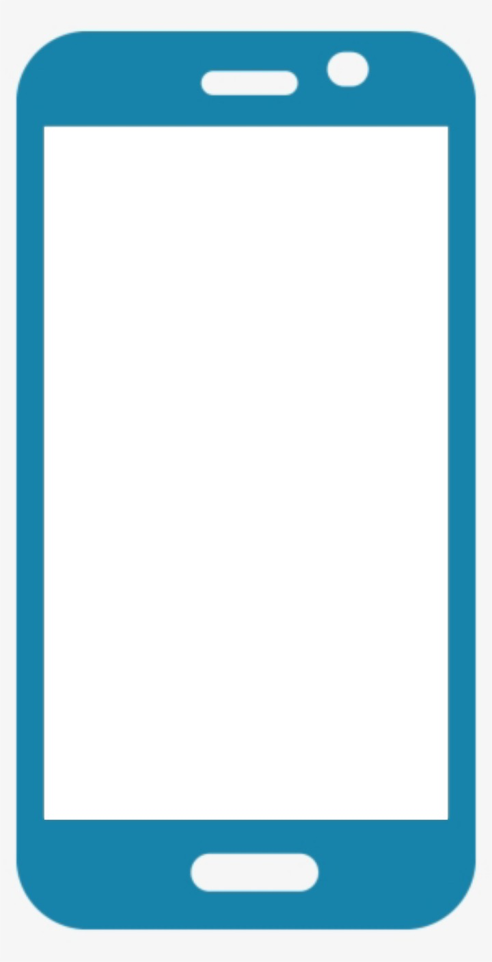
Welcome to the homeQurrantine application Prototype
Login with your phone no.
If your no. is registered as home quarantine then.
If your no. is not registered as home quarantine then.
Home qurrantined
Not Home qurrantined
😑
😃
Asks: is this the place where you are home qurrantined.
If yes, then places a marker/getTag your location and made a circle of 30m radius.

Slide 2
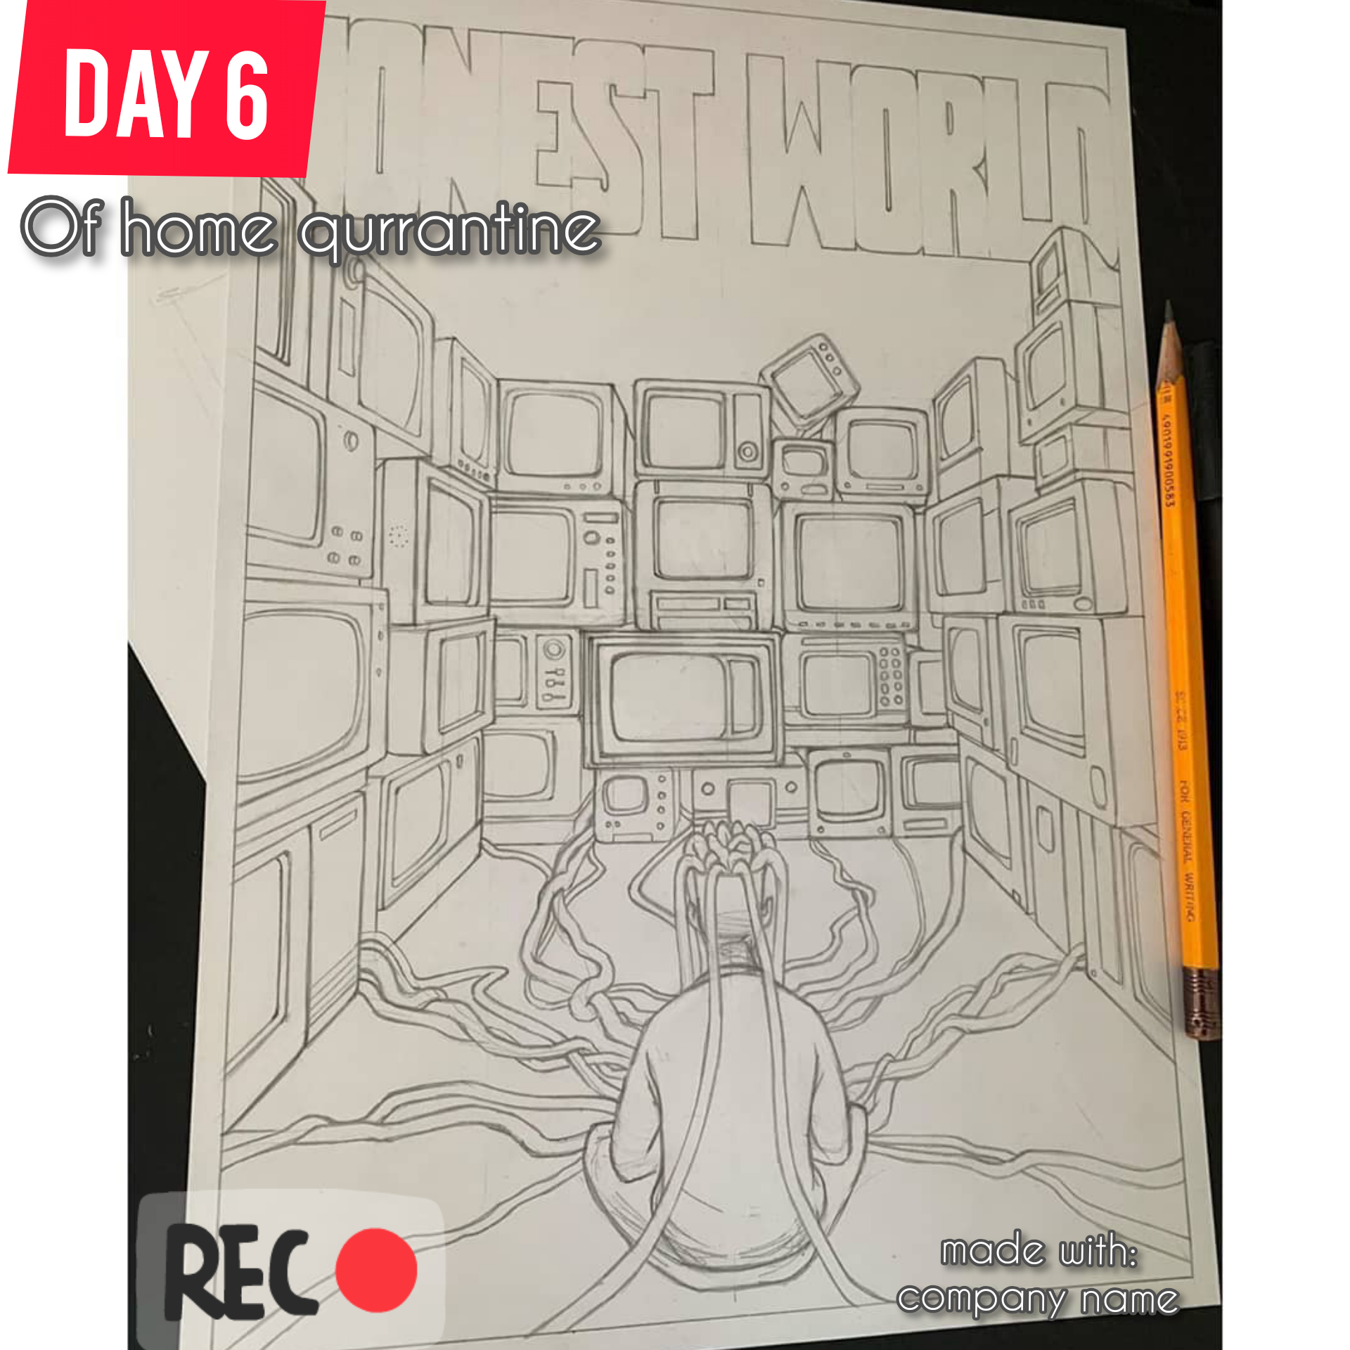
If you’re registered to be home qurrantined, then it will geotag you and will make a circle of 30m radius, and will ask you to stay within it.
Home qurrantined
Day 1
A timer will start for upto 14days.
Take a Selfie: 📸
You will be asked to upload a selfie each day.
You can also share to the world what you did in qurrantine.
Progress : 7%
[buissness aspect]:
watermark will be there below image, so in future we will get recognition and also our app will become popular.
Share to the world what you did today

Slide 3

If the person gets out of the circle, four target audiences will be get notified.
1. The person itself will get notification, to go in their respective houses otherwise will get fined/penalized.
2. People who are in within 1Km radius, of that person, will get notified.
3. People who are near that person, will get notified by the bluetooth notification,.
4. At the instant, th person leave the circles, police will get its realtime location on their maps, in their control rooms, so an automated call can be made.

Slide 4
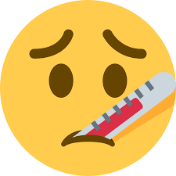


Home qurrantined
Day 8
If the person develops symptoms over a week, In such a case, people can get to know the private labs nearby and book their Covid19 test with the private labs and the app can effectively earn from a percentage of money charged for the appointment made by the private lab.
Take a Selfie: 📸
Progress : 57%
Symptoms
FEVER
DRY COUGH
TIREDNESS/COLD

